Slide 1

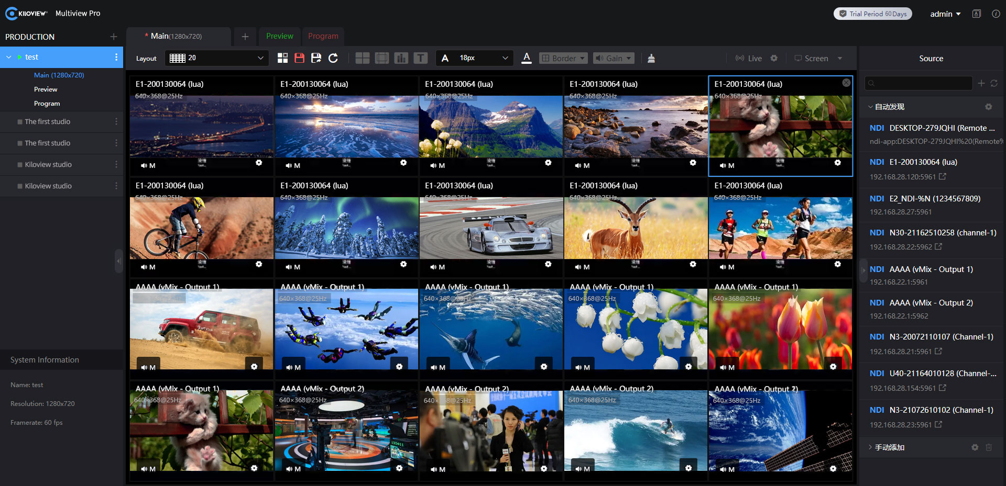
Multiview Pro
User Manual V2.2
长沙千视电子科技有限公司

Slide 2
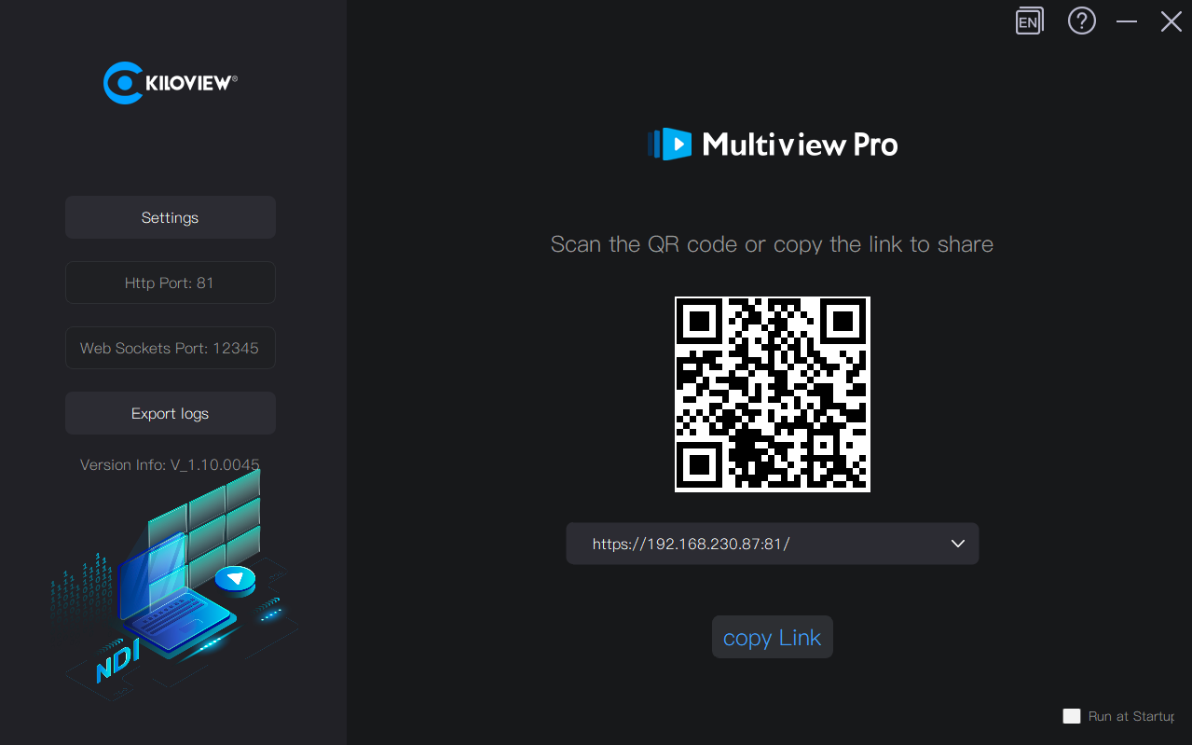
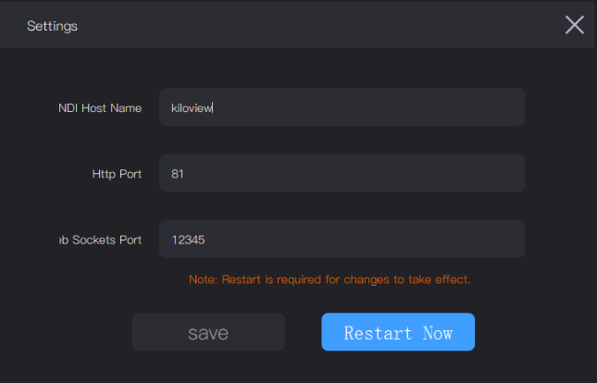
Open Multiview Pro, copy or enter the link into a web browser, or use a mobile device (tablet, iPad) to scan the QR code to access the Multiview Pro client. (The default login username and password are: admin/admin)
In the settings, you can modify the NDI hostname and login port.
长沙千视电子科技有限公司

Slide 3
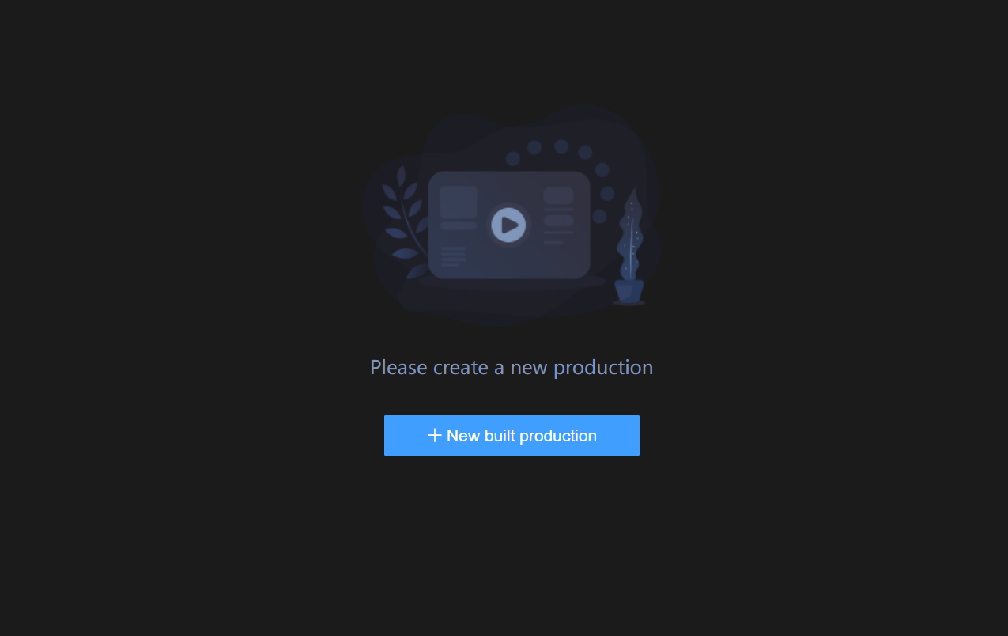
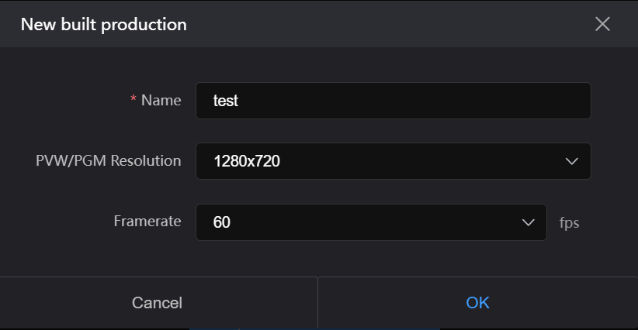
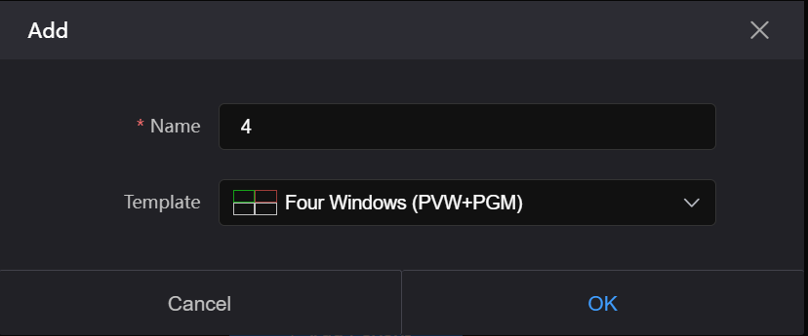
After logging in on the web, you first need to create a project. The project supports a maximum resolution of 3840x2160 and also allows for custom resolutions. Once the project is created, you need to add a layout. The interface will display several common split-screen modes by default, which you can choose to switch between. It supports up to 20 split screens.
长沙千视电子科技有限公司

Slide 4
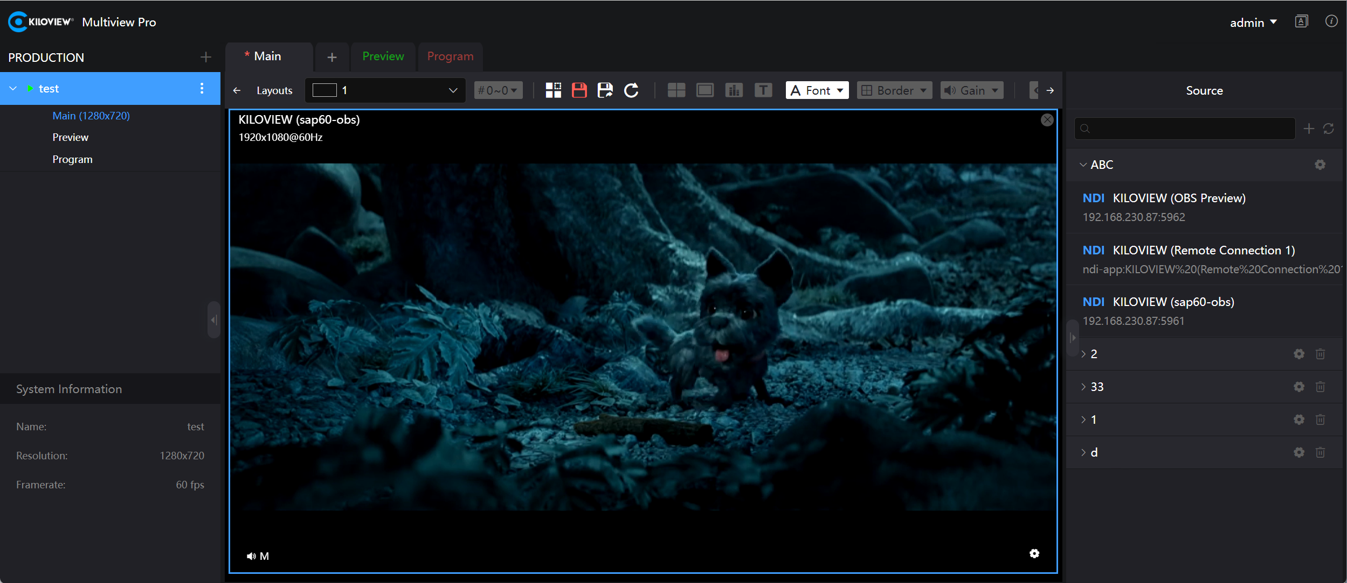
Display information such as video source name, resolution, etc.
After discovering the video source, drag it into the layout window for playback monitoring.
Video source list - Automatically discover NDI sources within the same local network.
长沙千视电子科技有限公司

Slide 5
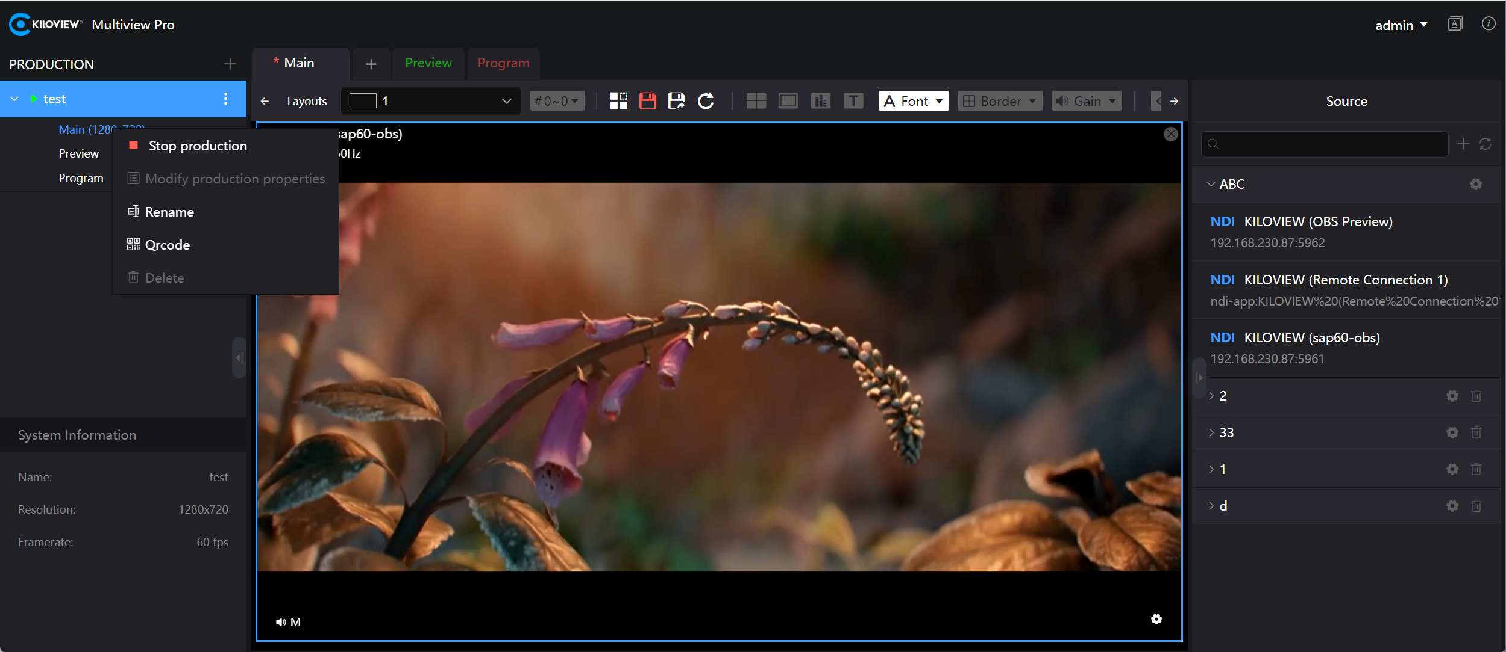
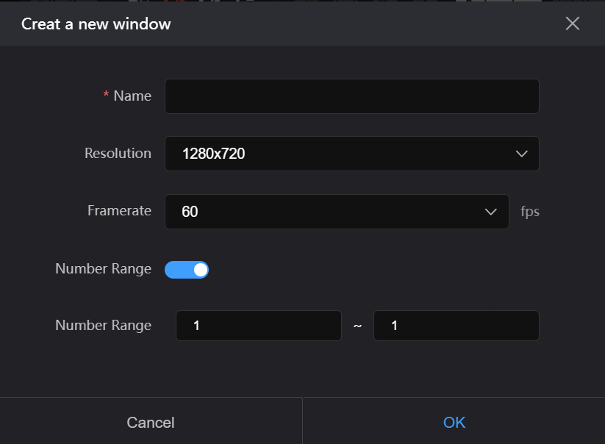
Add a new production, with the ability to customize the name and set the resolution and frame rate for PVW and PGM.
Create a new window， the name can be customized and supports setting a number range and frame rate.
Modify properties, rename, and perform other operations on the current production.
长沙千视电子科技有限公司

Slide 6
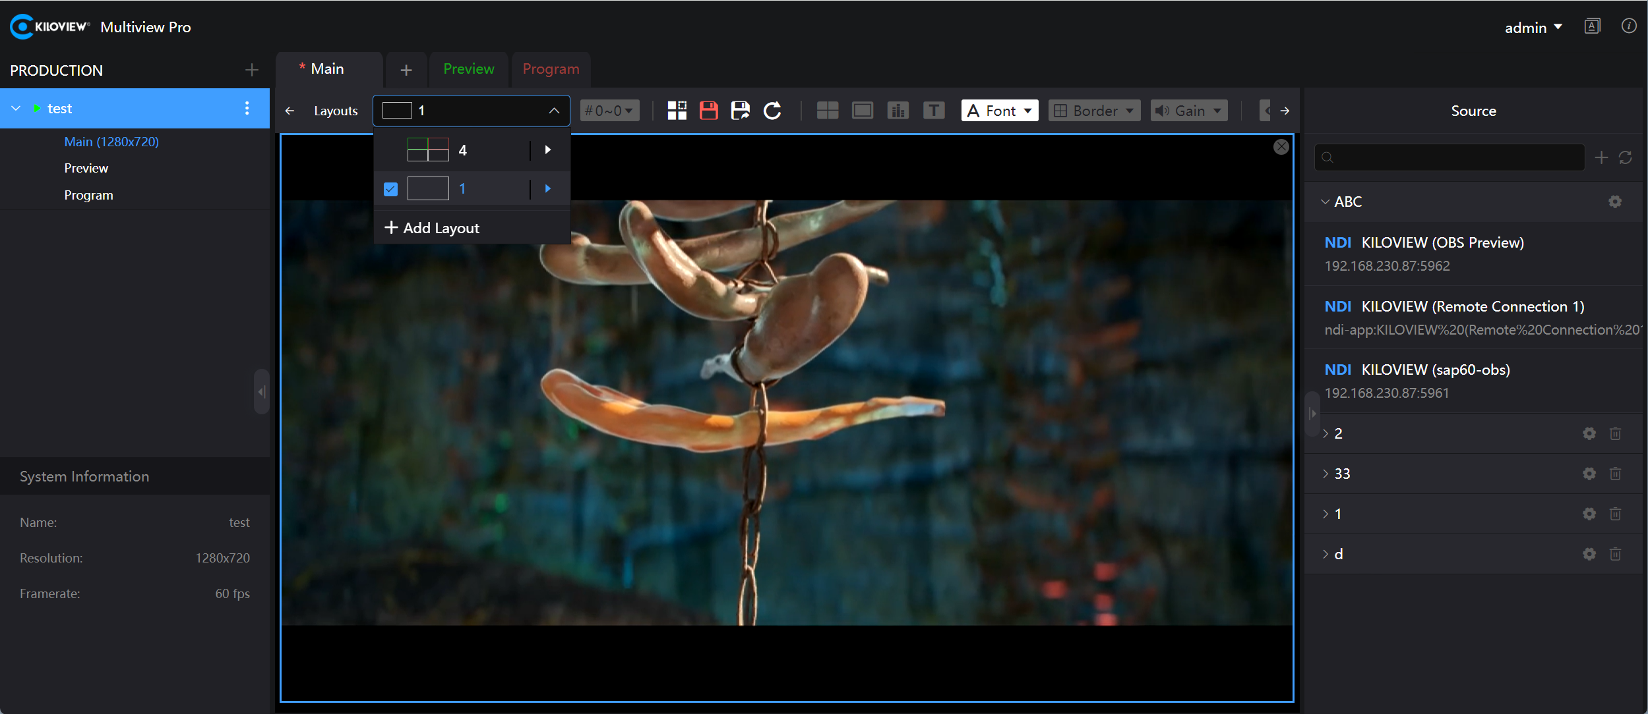
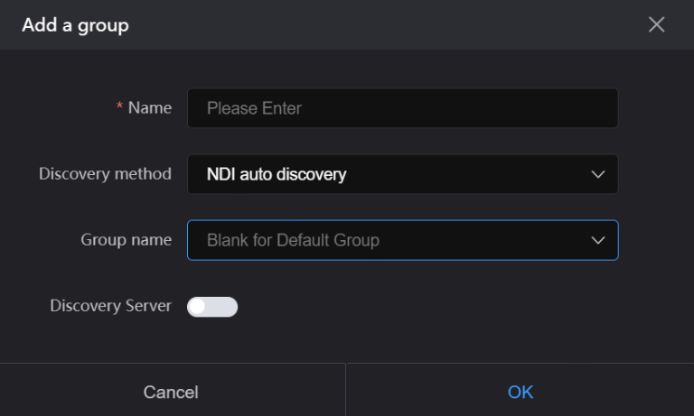
It displays the currently added NDI source groups, with the default being the source list for automatic discovery. Users can add new NDI source groups manually according to their work requirements.
After adding a new layout in the software, you can use the desired layout from the list.
长沙千视电子科技有限公司

Slide 7
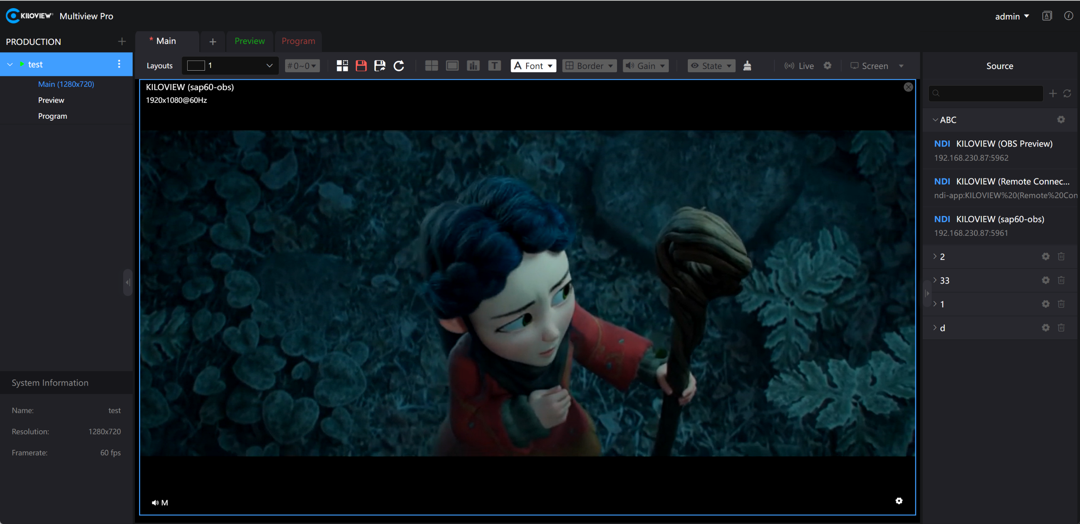










Toolbar Parameter Description
Icon | Explanation
 | Switch system language
 | Edit layout, save current layout content, and save current layout as a new one
 | Enable and disable the display of center lines for all playing video sources
 | Enable and disable safe frames for all playing video sources
 | Enable and disable audio level meter display for all playing video sources
 | Enable and disable name display for all playing video sources
 | Enable setting of font size and color for names
 | Enable and disable border overlay for all playing video sources and set border color
 | Enable and disable audio gain for all playing video sources and set audio gain parameters
 | Enable and disable display of NDI source channel information and resolution information
 | Clear all content in the current layout
 | Enable and disable NDI output for the current layout
 | Enable computer multi-screen switching, allowing content from the main screen to be switched to any split screen
长沙千视电子科技有限公司

Slide 8
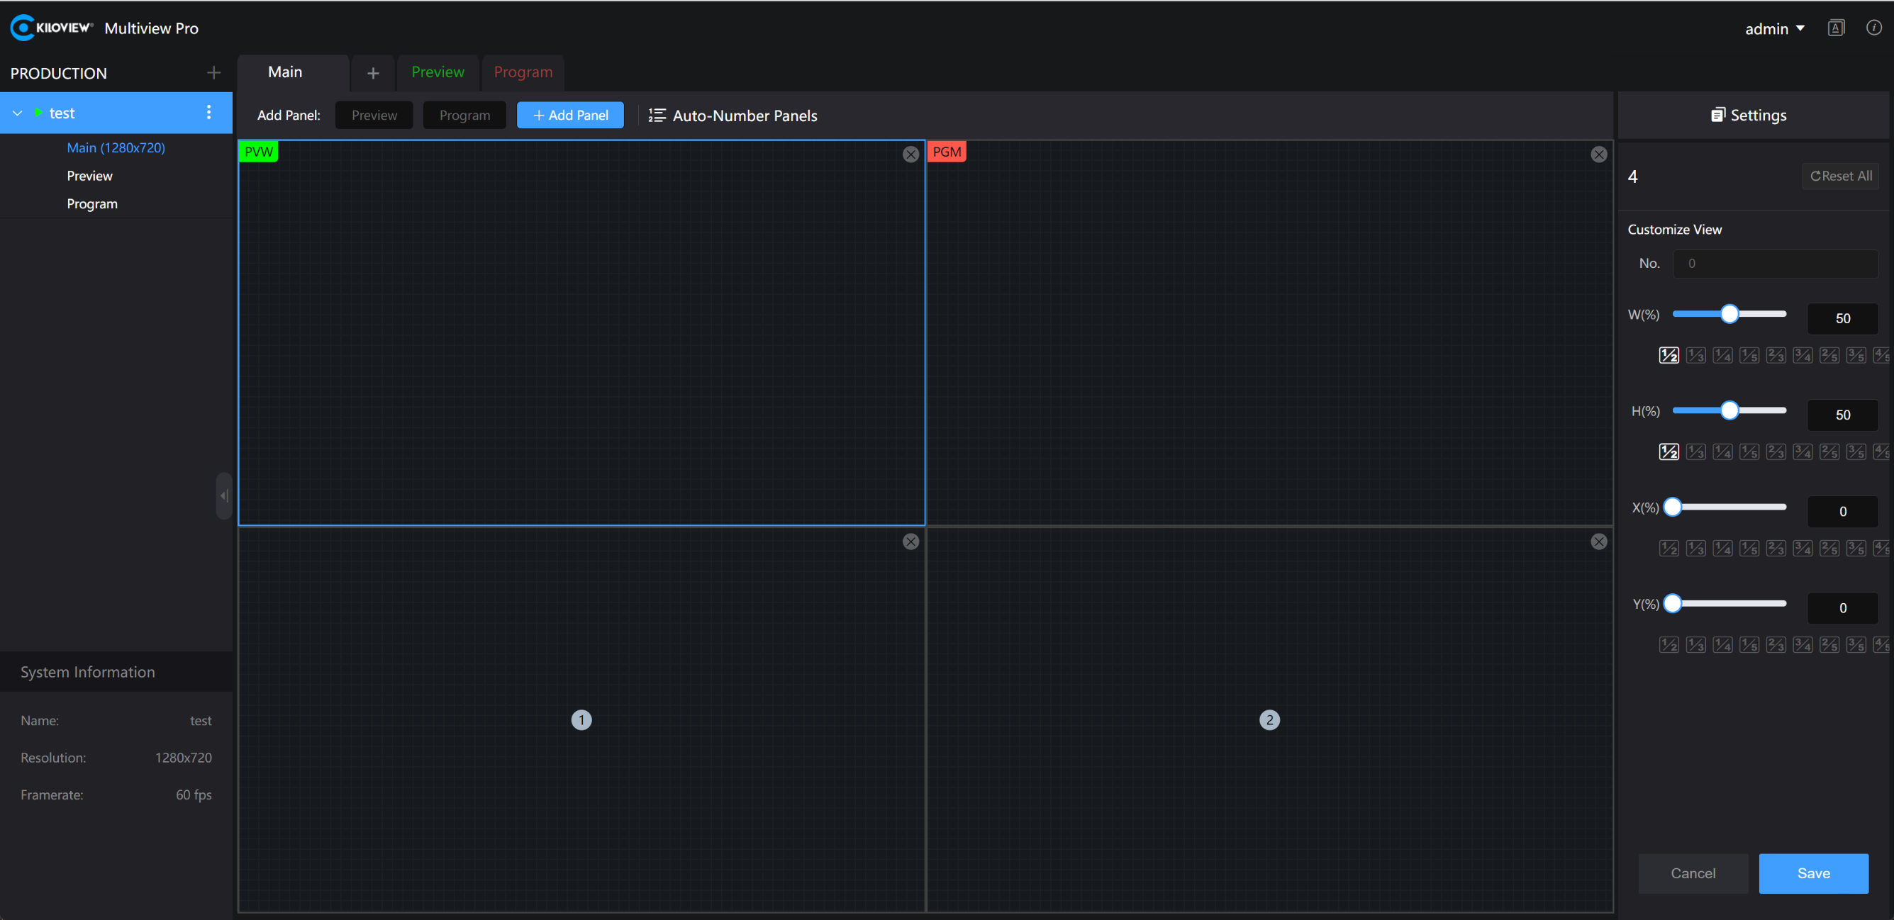
After clicking “Edit Layout,” you can customize the layout according to your needs by adding, deleting, and adjusting the size. It supports multi-pane layer processing, such as bringing a layer to the front or moving a layer up.
The size and position of the modules in the layout can be adjusted by clicking and dragging with the mouse or by using the “Width,” “Height,” “Horizontal,” and “Vertical” options on the right.
长沙千视电子科技有限公司

Slide 9
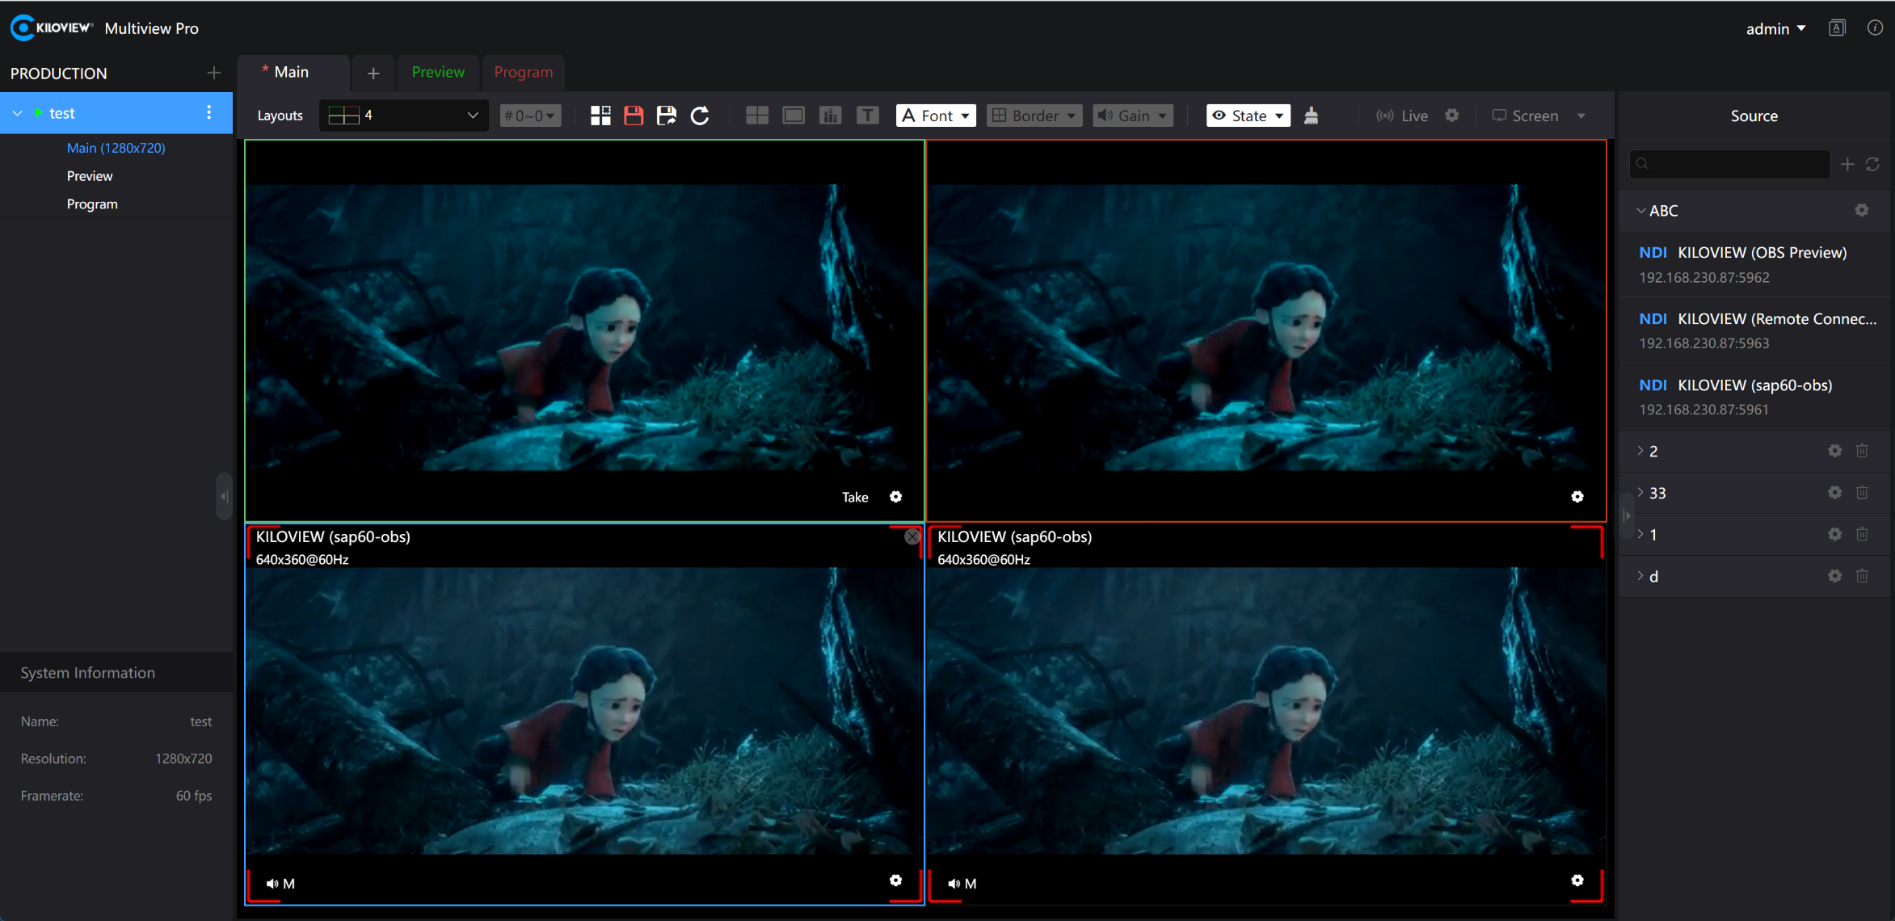
The image within the green frame represents the PVW (Preview) signal
The image within the red frame represents the PGM (Program) signal
Click PVW/PGM to enter full-screen monitoring of the current PVW/PGM signal video.
长沙千视电子科技有限公司

Slide 10
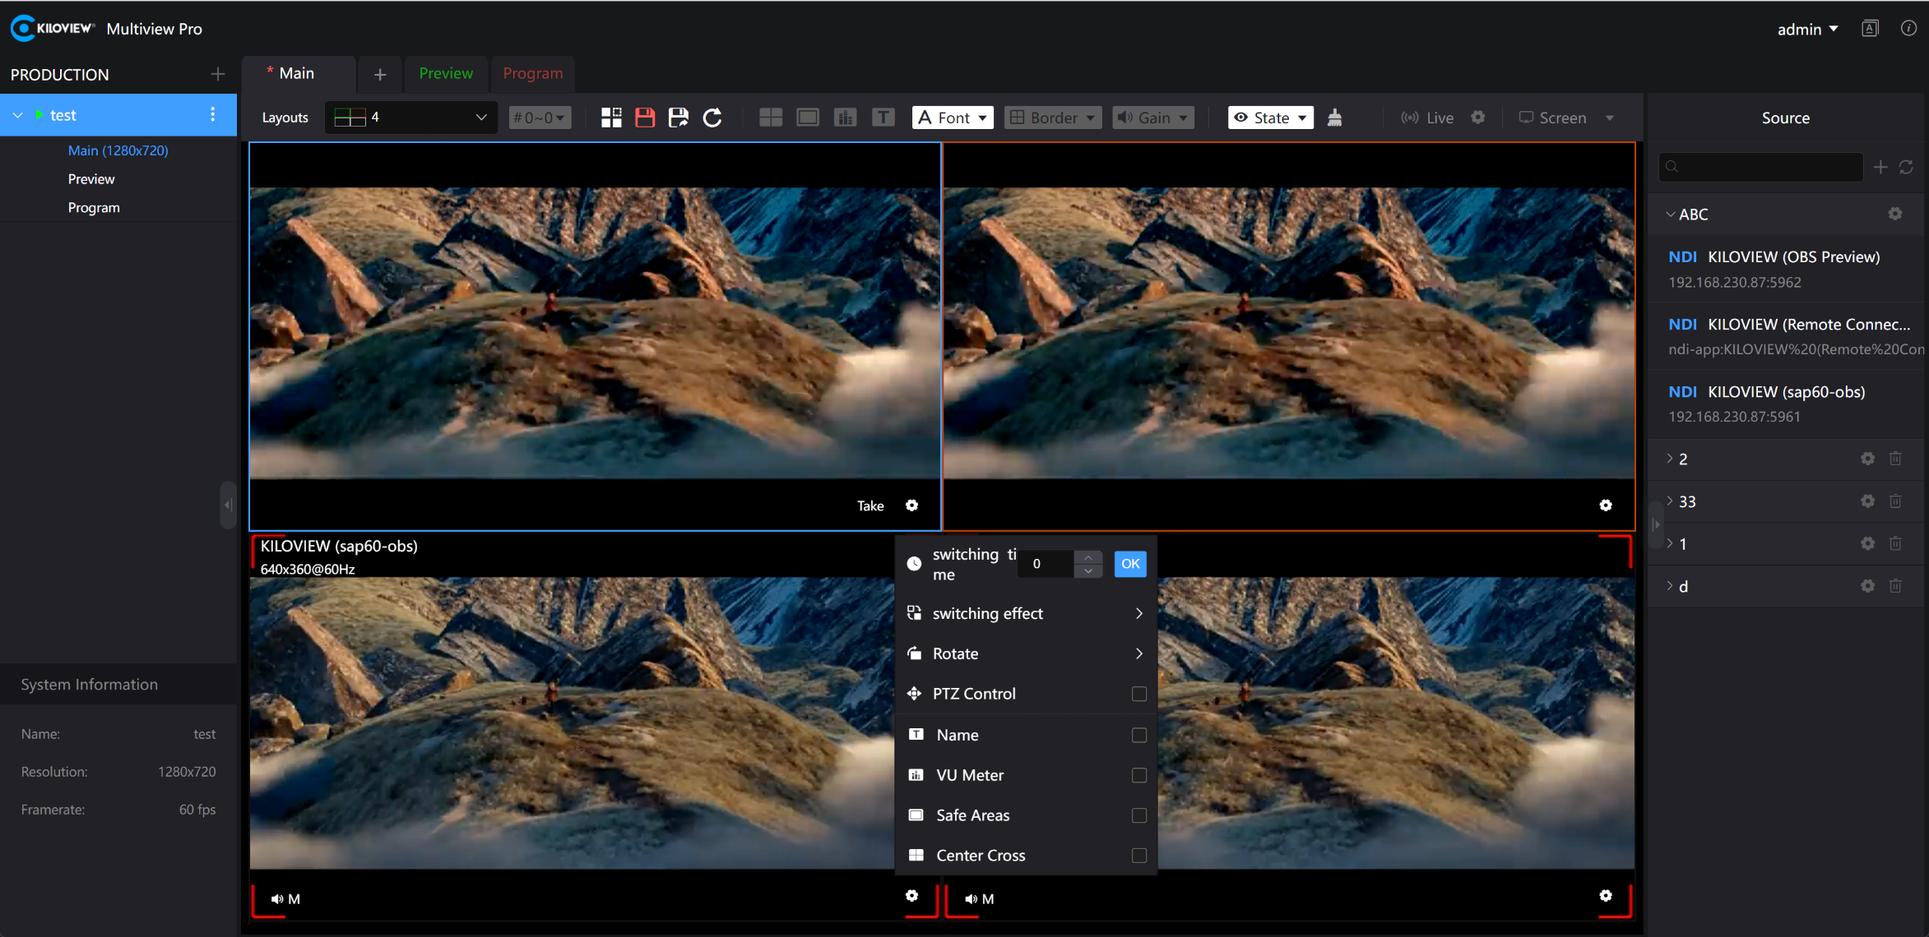
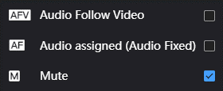
The PVW settings option supports Take transitions. By clicking Take, you can switch the video between PVW and PGM signals. It also supports setting transition effects. Additionally, it allows you to edit the title name of the video source, enable name display, audio meters, safety frame, center line, and PTZ control.
The default state for audio settings is mute (M).
Audio Assigned indicates that the audio is locked to output from the PGM.
Audio Follow Video (AFV) means the audio follows the video.
长沙千视电子科技有限公司

Slide 11
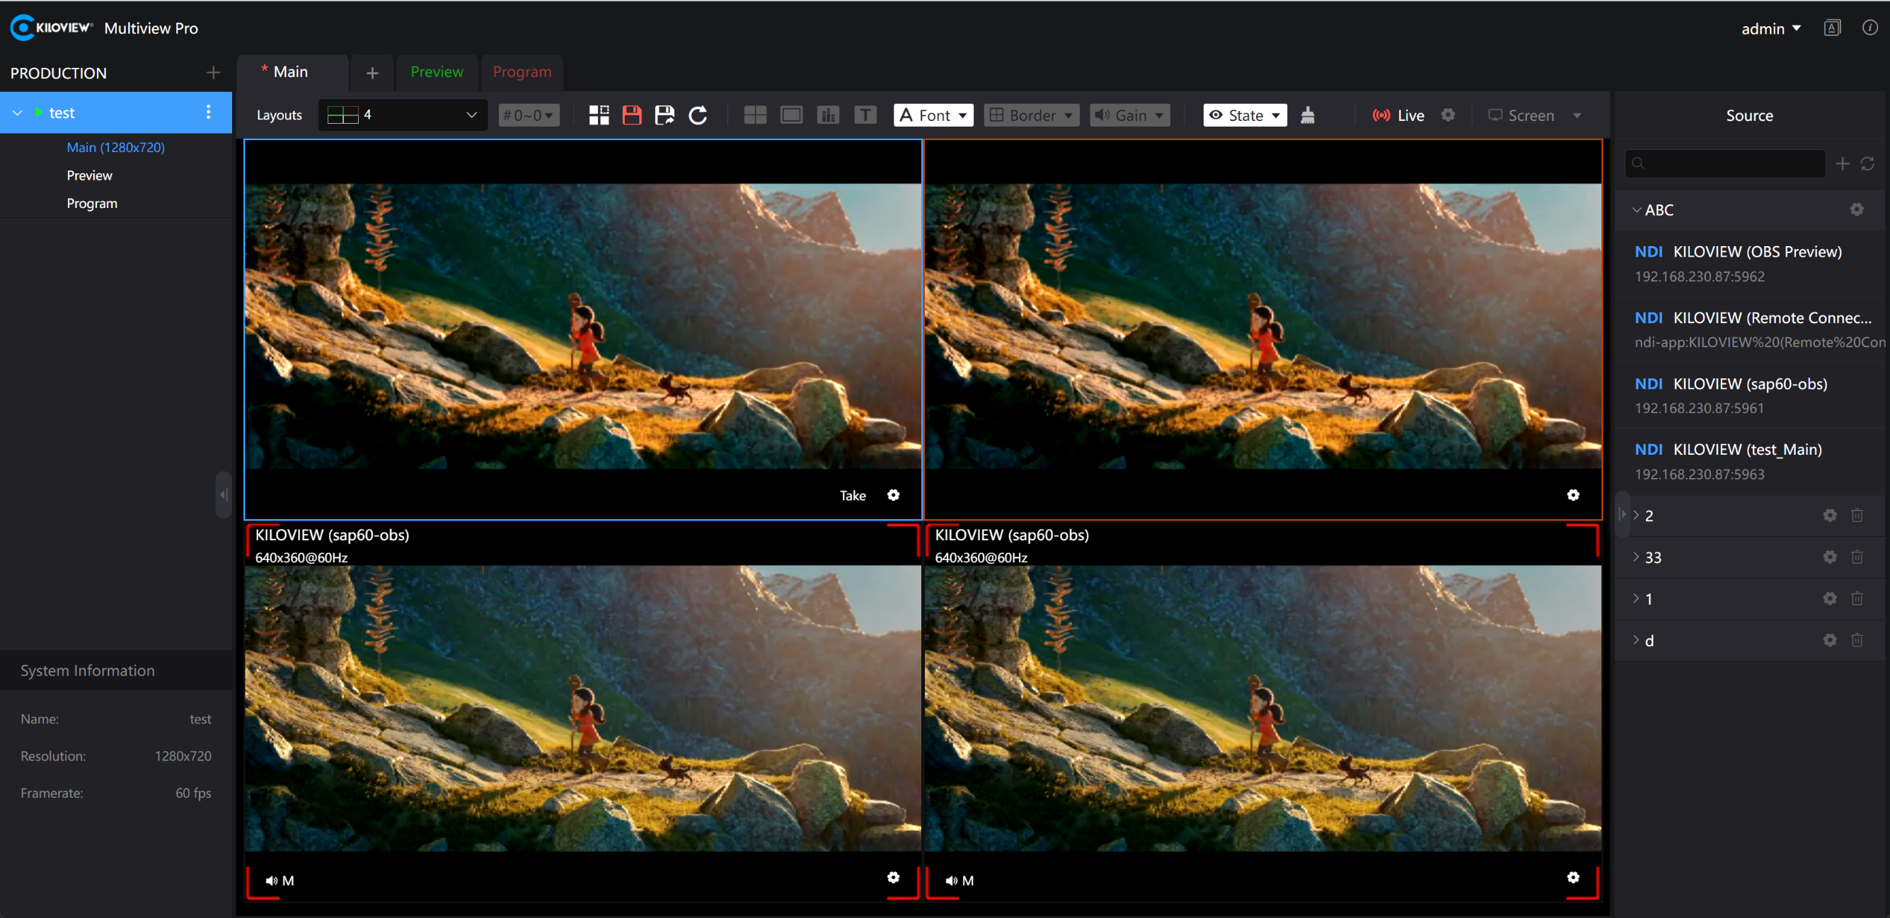
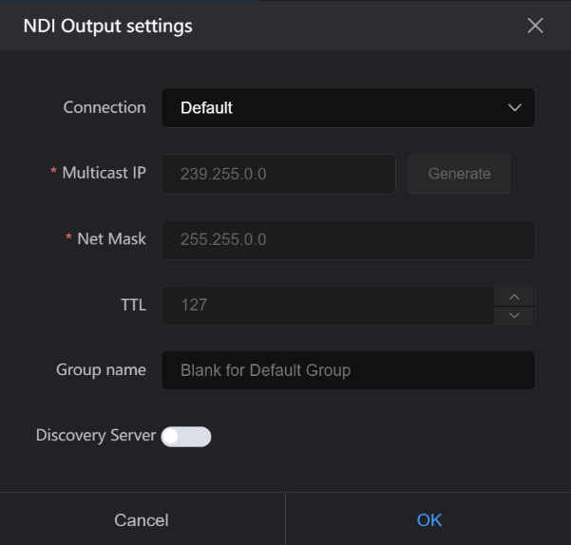
To start live streaming on the Main page means to output the current page’s image content via NDI live stream. If you need to adjust the resolution and frame rate of the NDI output, you must modify the Main window properties.
By clicking the live streaming settings button, you can configure the NDI connection settings. This includes enabling multicast mode for connection, setting the NDI group, and configuring the NDI discovery server.
Modify the Main Window Properties
长沙千视电子科技有限公司

Slide 12
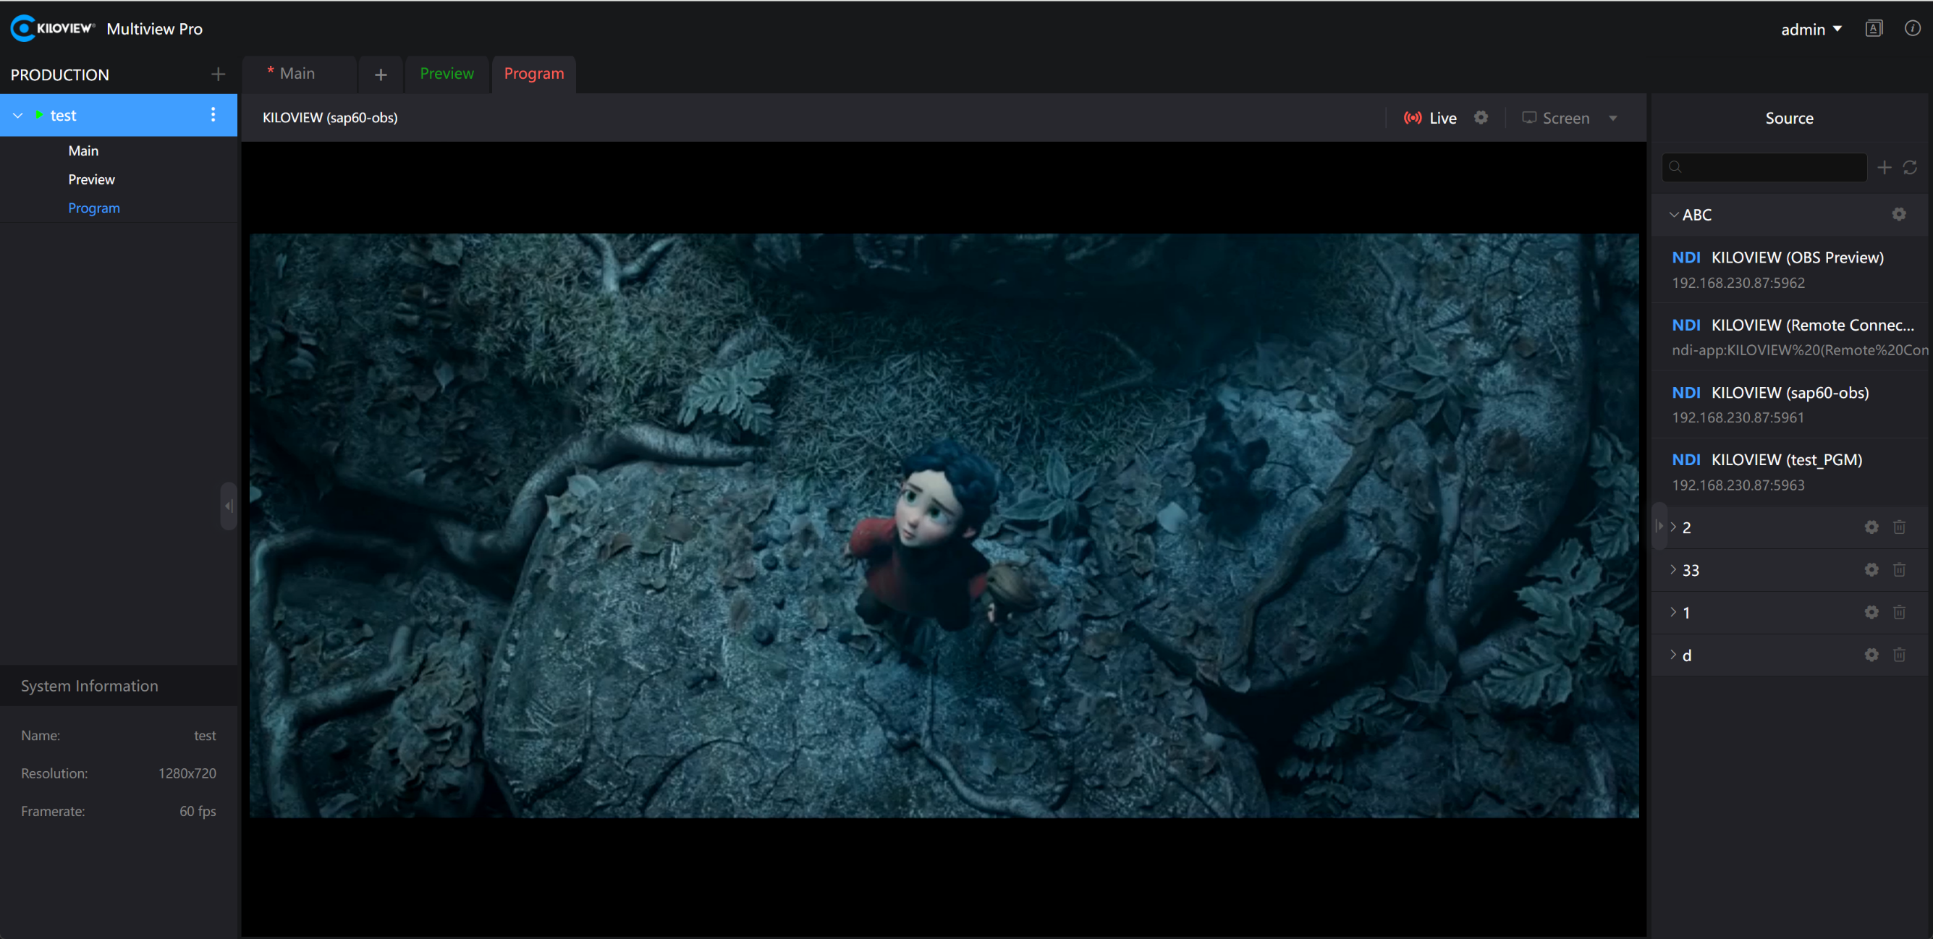
Enabling live streaming on the PVW/PGM page indicates that the current page’s image content will be output as an NDI live stream. The Take function is supported to switch video between PVW and PGM.
If you need to modify the resolution and frame rate of the NDI output, you must adjust the current production properties. Before modifying production properties, you need to stop the production first, then make the changes.
Modify Production Window Properties
长沙千视电子科技有限公司

Slide 13
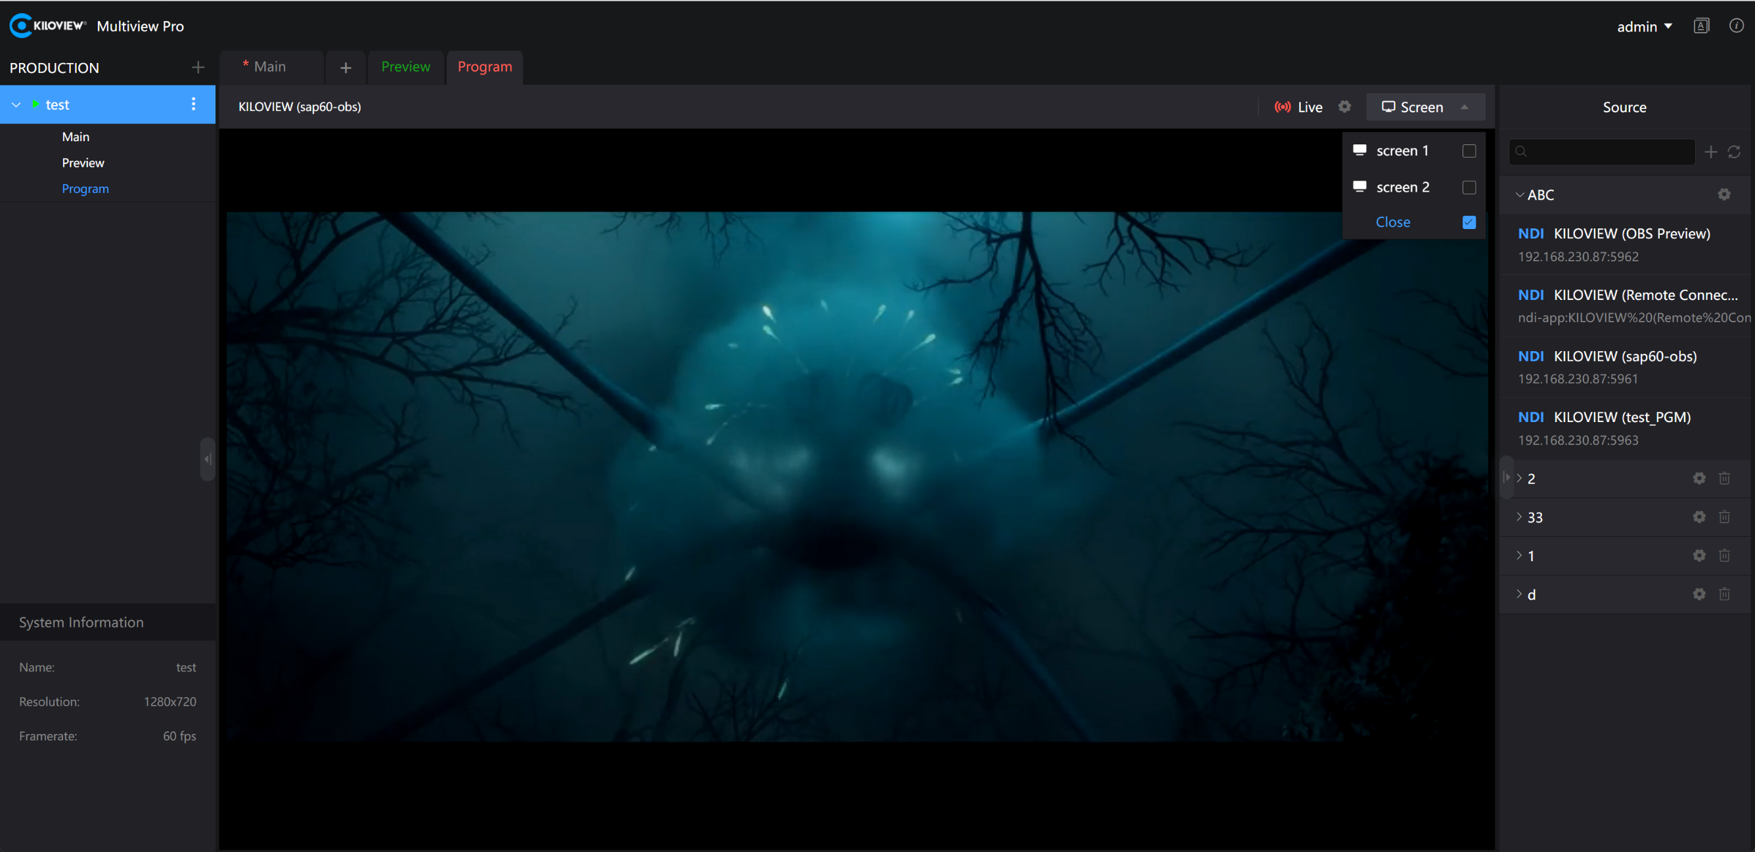
Configure through the “Screen” option to send the current video preview to other corresponding screens for display. You can use the one-click full-screen feature to expand the view on the corresponding monitor window.
长沙千视电子科技有限公司

Slide 14
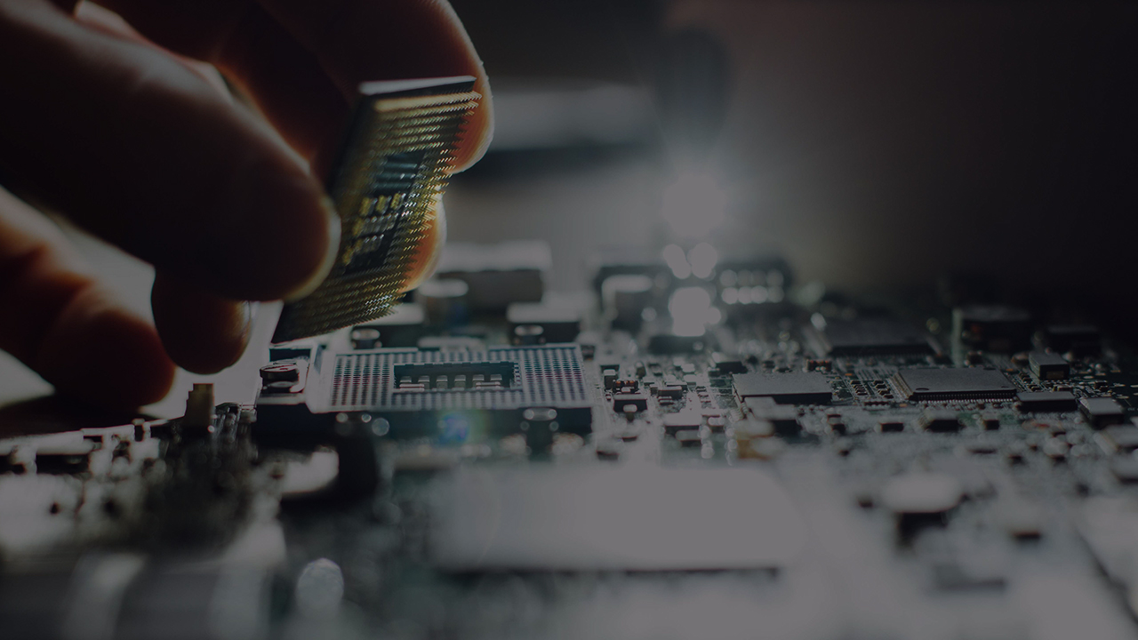

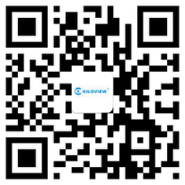

让“视界”畅通无阻！
长沙千视电子科技有限公司
电话：18573195256 邮箱： sales@kiloview.com 技术支持：support@kiloview.com 地址:长沙市雨花区汇金路877号嘉华智谷产业园长沙屿B4栋106、109号

